Slide 1
Search and retrieval in Alma and Alma Analytics according to the contents of holdings records
Yoel Kortick. Senior Librarian

Slide 2
Contents
I | Introduction
II | The configuration
III | Sample holdings records and their retrieval in Alma – Example One
IV | Sample holdings records and their retrieval in Alma – Example Two
V | Alma Analytics

Slide 3
Introduction
It is possible to retrieve records in Alma and Alma analytics according to a wide variety of fields in the holdings record.
In addition, it is possible to index additional "local" fields.
See MARC 21 Holdings Tags and Mapped Search Indexes in the on line help for more information.
The next two slides show the default indexes and the associated fields and subfields.

Slide 4
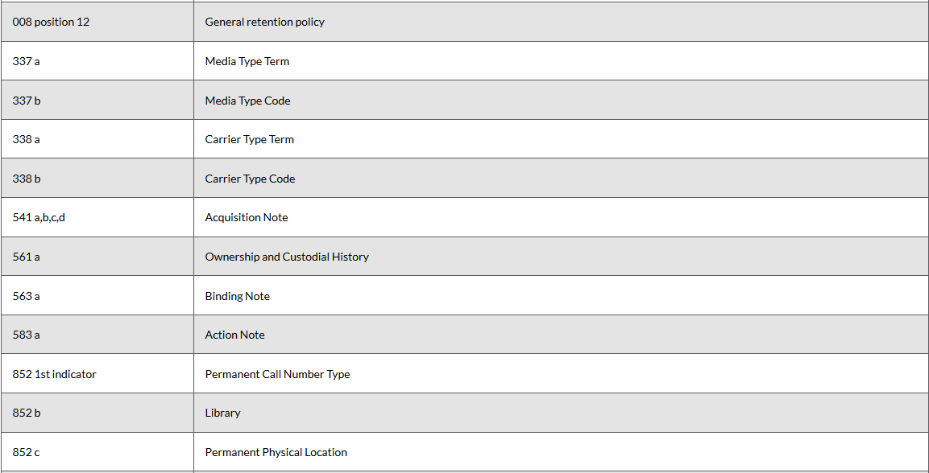
Introduction

Slide 5
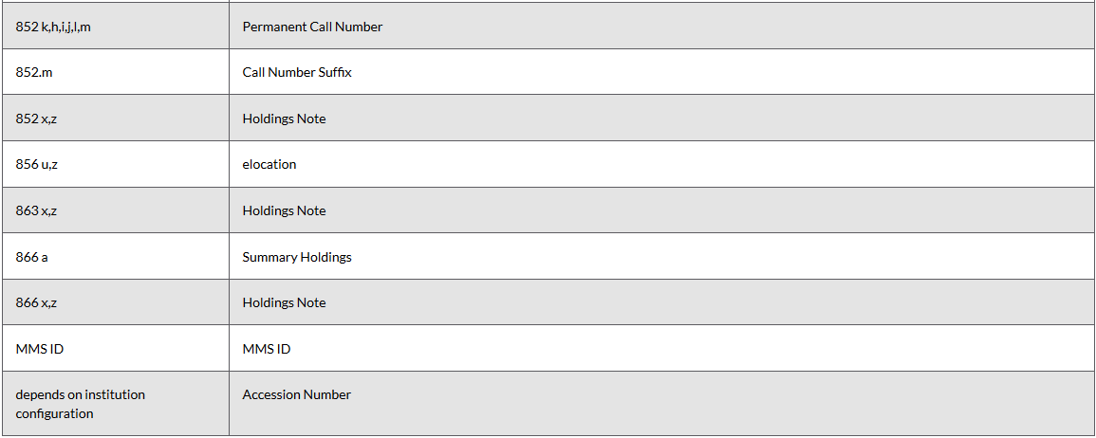
Introduction

Slide 6
Contents
I | Introduction
II | The configuration
III | Sample holdings records and their retrieval in Alma – Example One
IV | Sample holdings records and their retrieval in Alma – Example Two
V | Alma Analytics

Slide 7
The configuration
There is no configuration necessary to enable and use the indexes listed in the previous two slides. All indexes are "ready to use".
If you wish to index local holdings fields then you need to enable the specific field and enter "true" to designate if it will be available in regular search or advanced search.
This is done at "Configuration > Resource Management > Search Configuration > Search Indexes"
On the next slide holdings record local field 796 has been enabled for use in the regular search.
If you wish to give a unique local name to a local holdings field index then this can be done at "Configuration > Resource Management > Search Configuration > Customize Indexes Labels"
On the next slide holdings record local field 796 has been named "Interdepartmental Statistics"

Slide 8
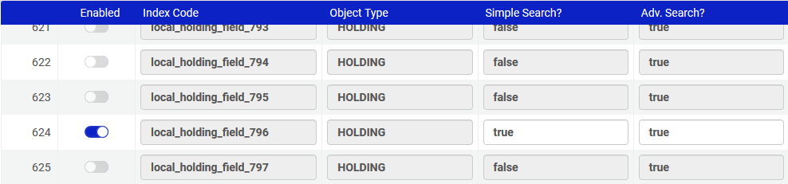
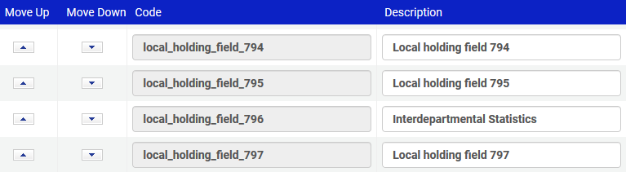
The configuration
Search Indexes
Customize Indexes Labels

Slide 9
Contents
I | Introduction
II | The configuration
III | Sample holdings records and their retrieval in Alma – Example One
IV | Sample holdings records and their retrieval in Alma – Example Two
V | Alma Analytics

Slide 10
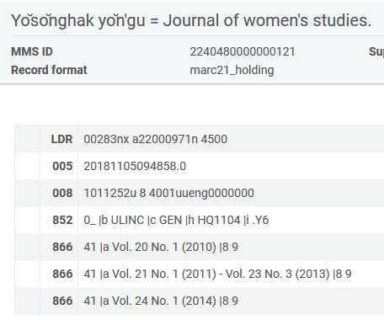
Sample holdings records and their retrieval in Alma – example one
Here is the holdings record for title "Yŏsŏnghak yŏn'gu = Journal of women's studies".
It contains field 866, which is defined as "Textual Holdings - Basic Bibliographic Unit"

Slide 11
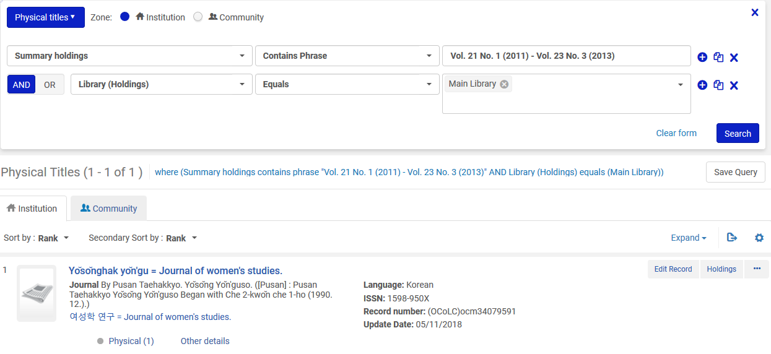
Sample holdings records and their retrieval in Alma – example one
The record is easily retrieved by searching for "Summary Holdings" (866 a) and "Library" (The name of the code in 852 b)

Slide 12
Contents
I | Introduction
II | The configuration
III | Sample holdings records and their retrieval in Alma – Example One
IV | Sample holdings records and their retrieval in Alma – Example Two
V | Alma Analytics

Slide 13
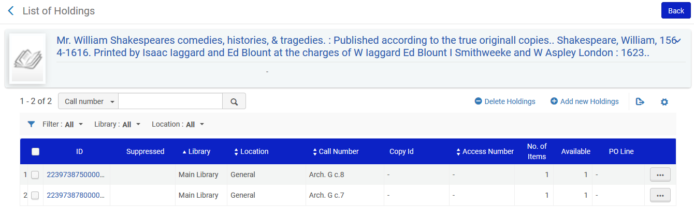
Sample holdings records and their retrieval in Alma – example two
Here are two holdings records for title "Mr. William Shakespeares comedies, histories, & tragedies. : $$b Published according to the true originall copies".
Each has a different call number (shelfmark) in 852 $$h
  Arch. G. c.7
  Arch. G. c.8
Each holdings record has 1 item

Slide 14
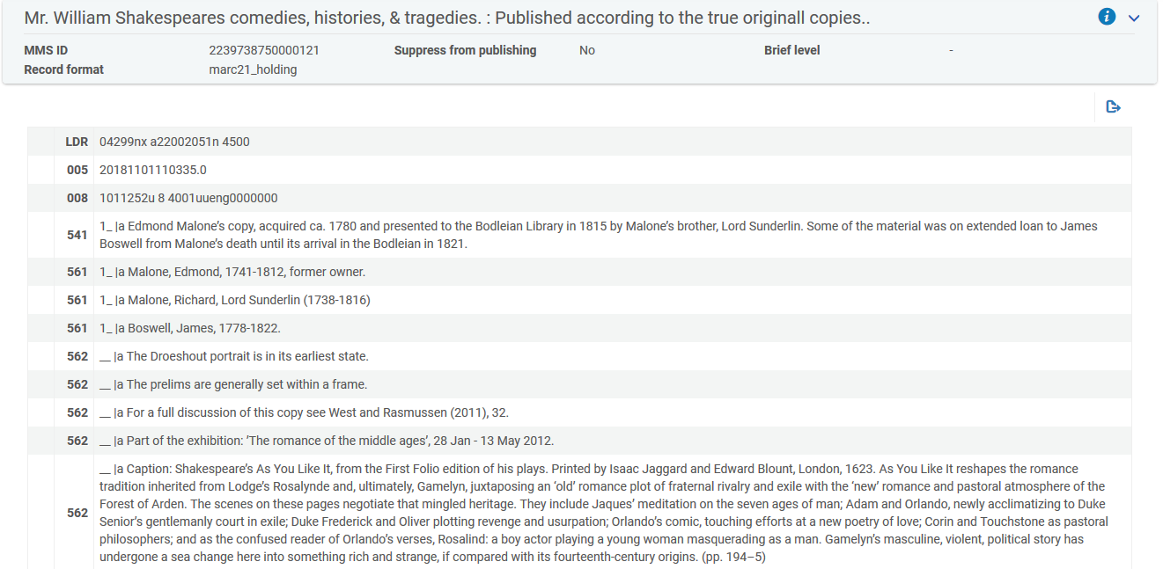
Sample holdings records and their retrieval in Alma – example two
Here is the holdings record which has the Call Number Arch. G. c.8
This is the beginning of the holdings record

Slide 15
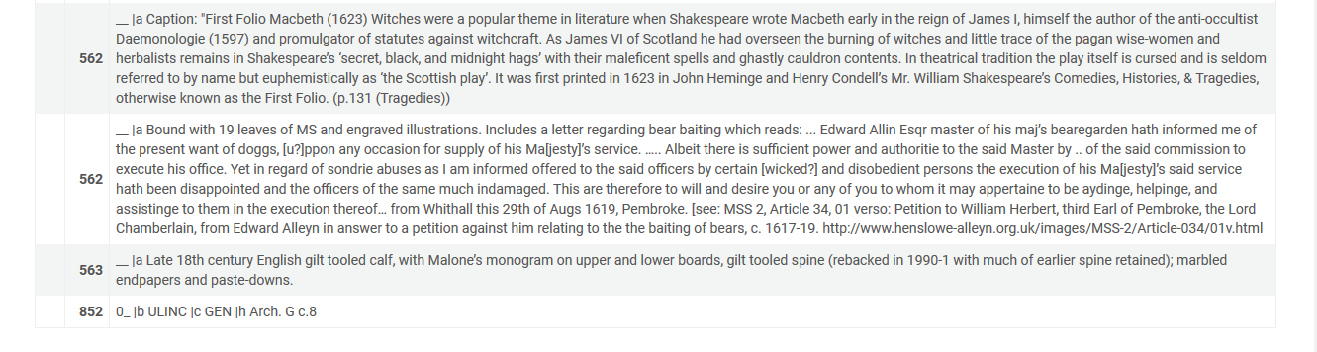
Sample holdings records and their retrieval in Alma – example two
Here is the holdings record which has the Call Number Arch. G. c.8
This is the end of the holdings record

Slide 16
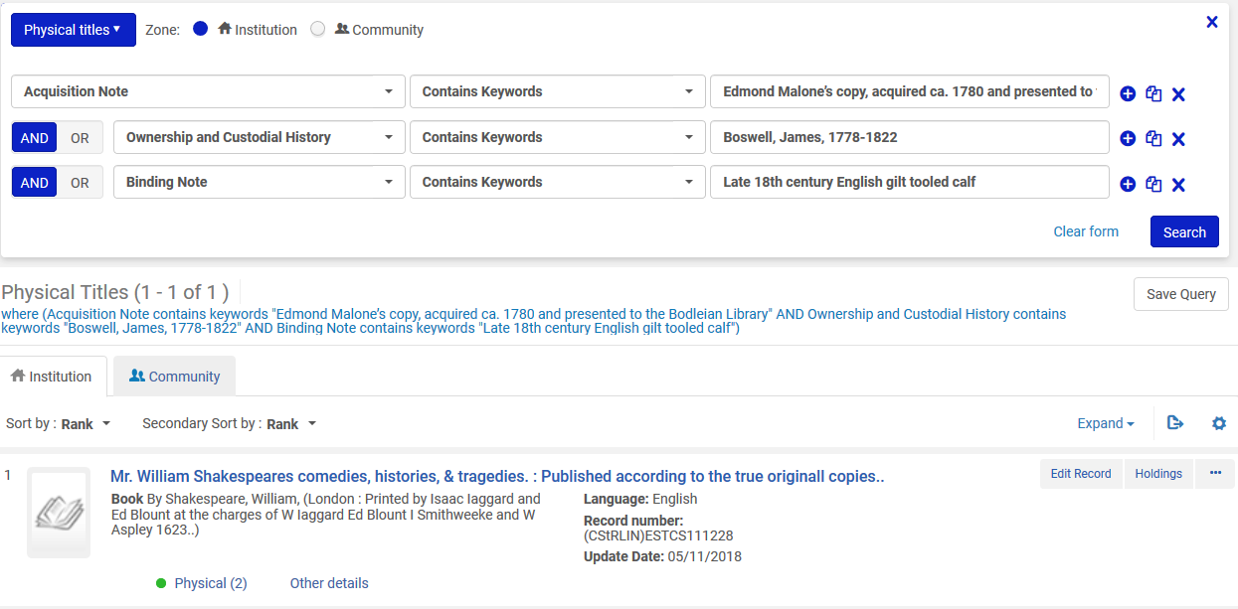
Sample holdings records and their retrieval in Alma – example two
The record is easily retrieved by searching for
  "Acquisition Note" (541 a,b,c,d)"
  "Ownership and Custodial History" (561 a)
  "Binding Note" (563 a)

Slide 17
Contents
I | Introduction
II | The configuration
III | Sample holdings records and their retrieval in Alma – Example One
IV | Sample holdings records and their retrieval in Alma – Example Two
V | Alma Analytics

Slide 18
Alma Analytics
24 different fields from the holdings records are available in Alma analytics.
See Alma Analytics Holdings Details for a list of these fields
This is in addition to 10 local fields which each institution can define.
The next three slides show the fields which by default are in Alma analytics.

Slide 19
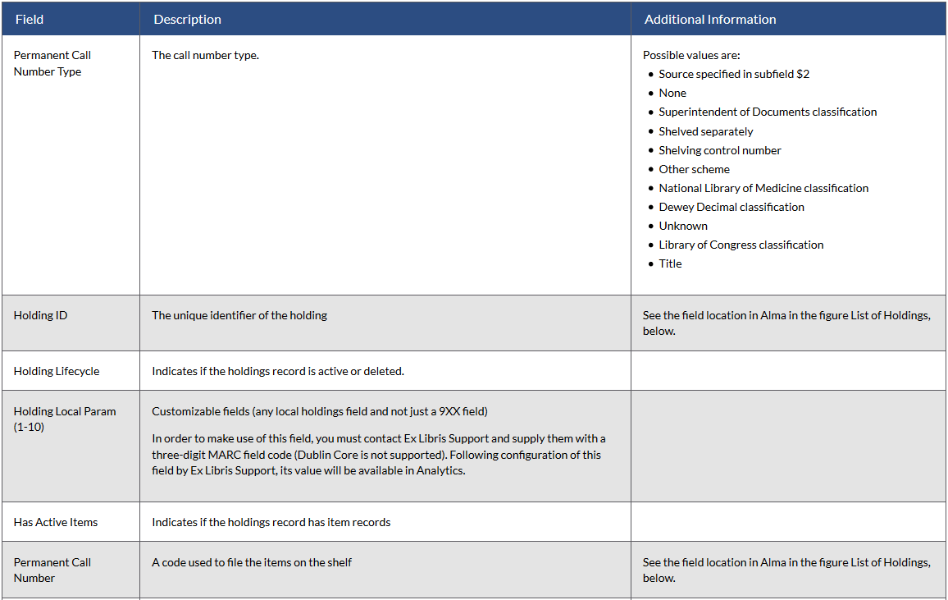
Alma Analytics

Slide 20
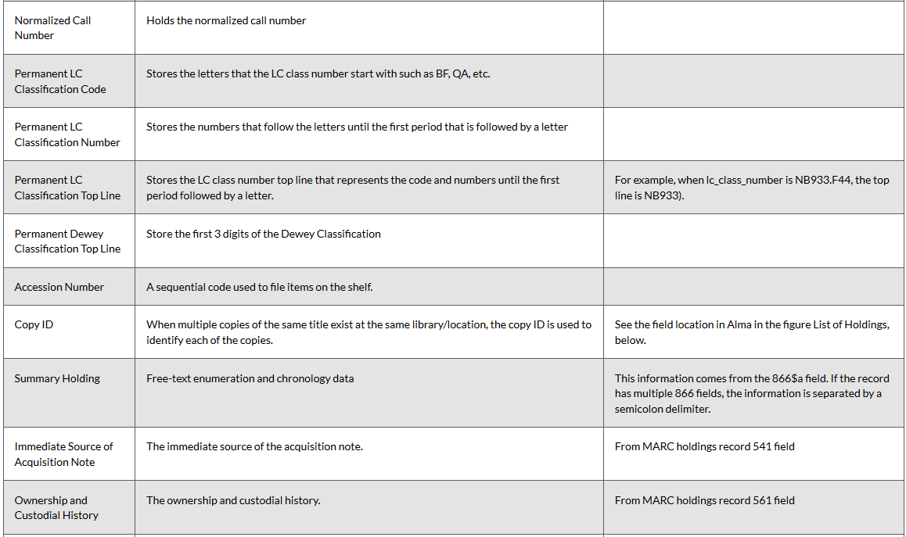
Alma Analytics

Slide 21
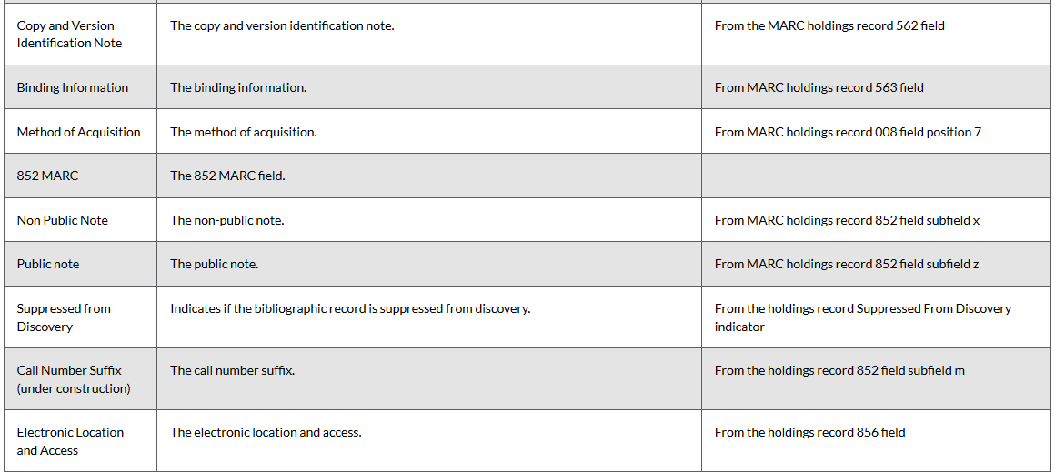
Alma Analytics

Slide 22
Alma Analytics
For example here we will make a report to display the following fields for MMSID 99162209000121 and 99165111200121 (the two records previously seen in this presentation):
  "Bibliographic Details"."MMS Id"
  "Physical Items"."Bibliographic Details"."Title"
  "Physical Items"."Holding Details"."Binding Information"
  "Physical Items"."Holding Details"."Copy and Version Identification Note"
  "Physical Items"."Holding Details"."Holding Id"
  "Physical Items"."Holding Details"."Ownership and Custodial History"
  "Physical Items"."Holding Details"."Summary Holding"

Slide 23
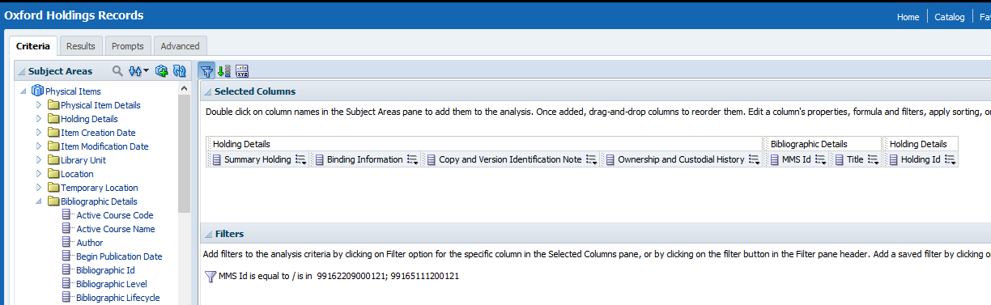
Alma Analytics
Here is the criteria tab

Slide 24
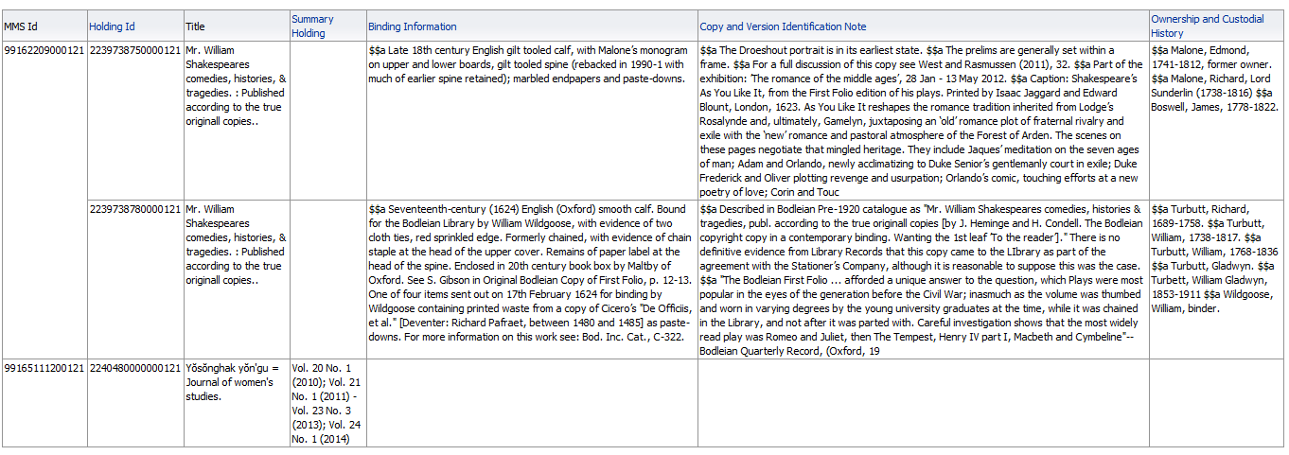
Alma Analytics
Here are results
Holdings record 562 field
Holdings record 561 field
Holdings record 563 field
Holdings record 866 field $$a

